Slide 1
Generative Adversarial Networks applied to multi-component seismic data
Author: Yuxuan Liu
Supervisor: Prof. Mike Warner,
Dr. Jiashun Yao

Slide 2
Overview
Problem
Data
Networks
Experiments
Conclusion

Slide 3
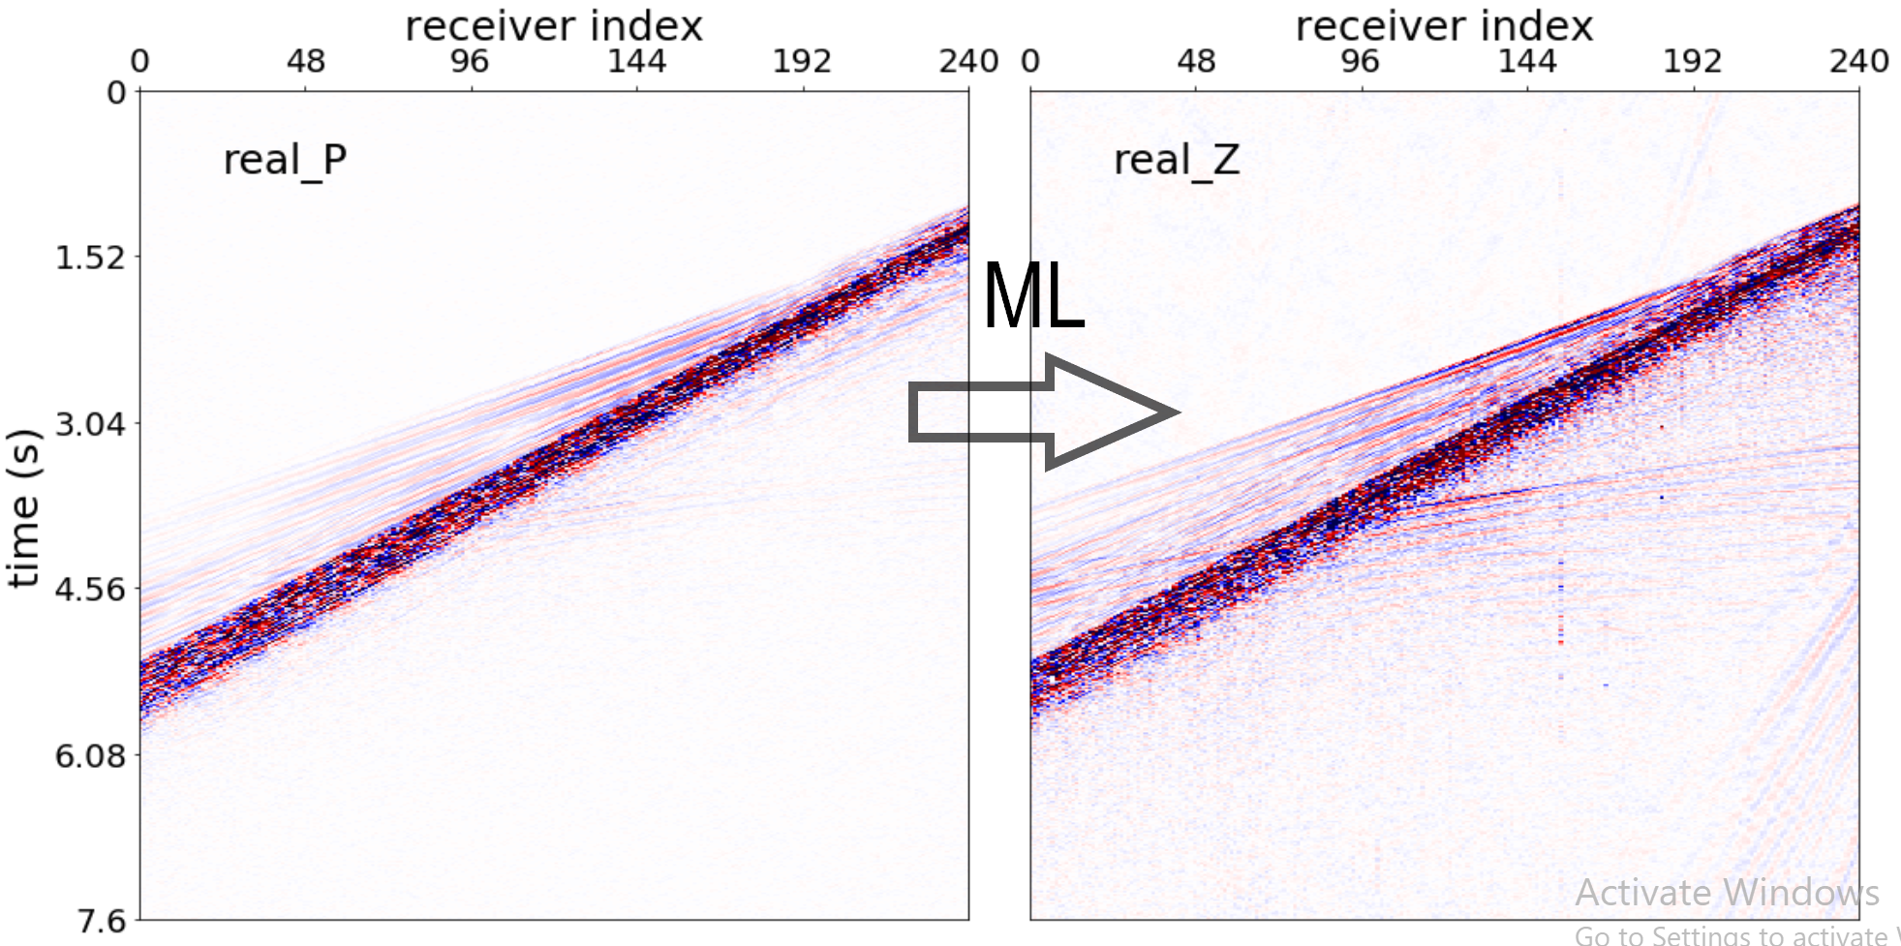
Problem
Machine Learning
Geophysics domain translation
Seismic data

Slide 4
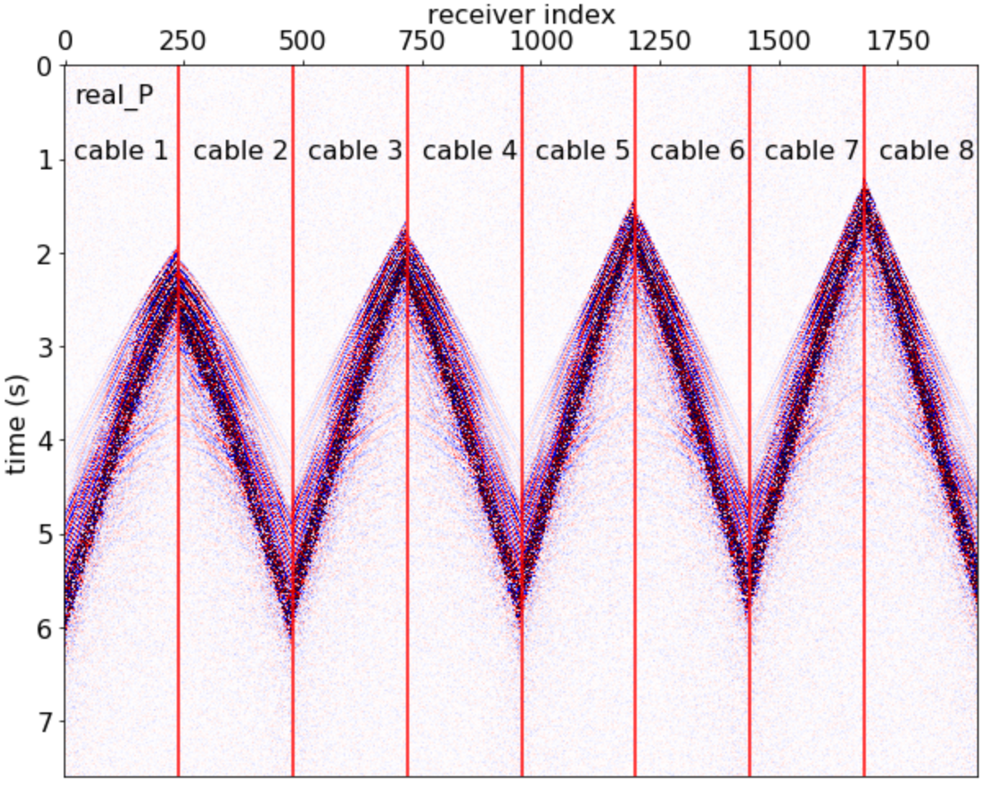
Data
Size: 3800 x 1920 pixels

Slide 5
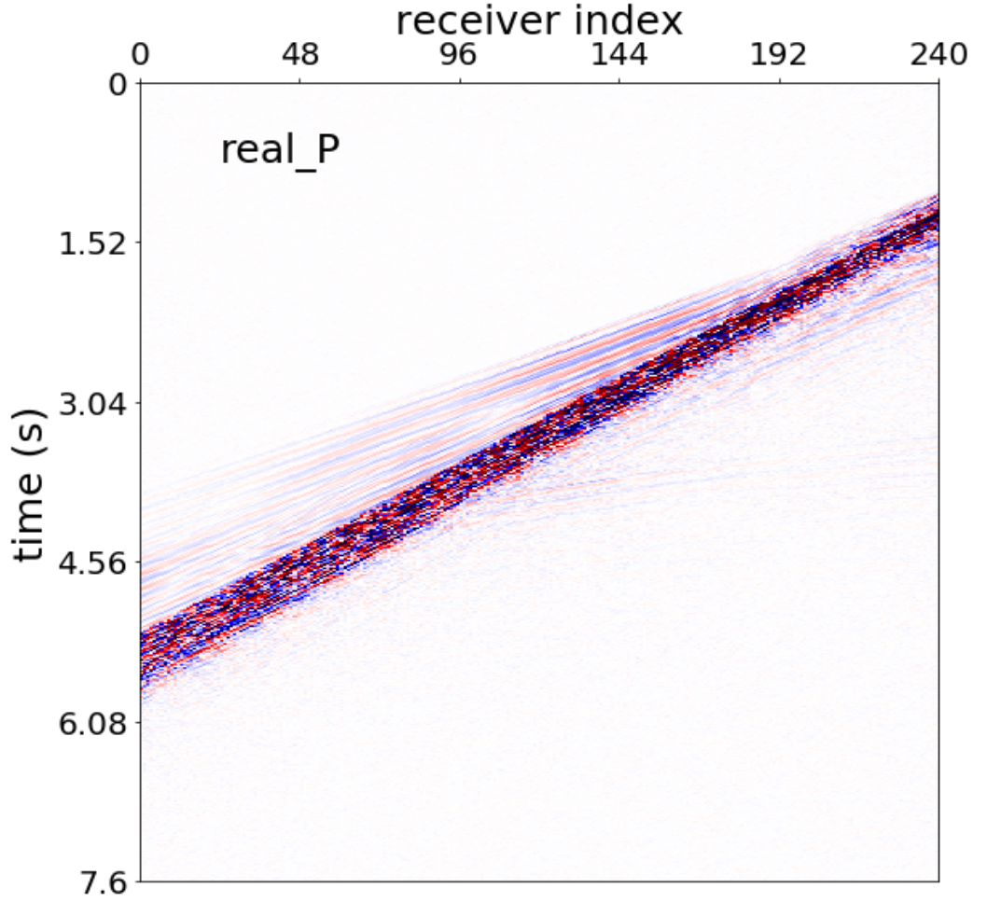
Data
Size: 3800 x 240 pixels
Train set: 1928 gathers
Test set: 408 gathers

Slide 6
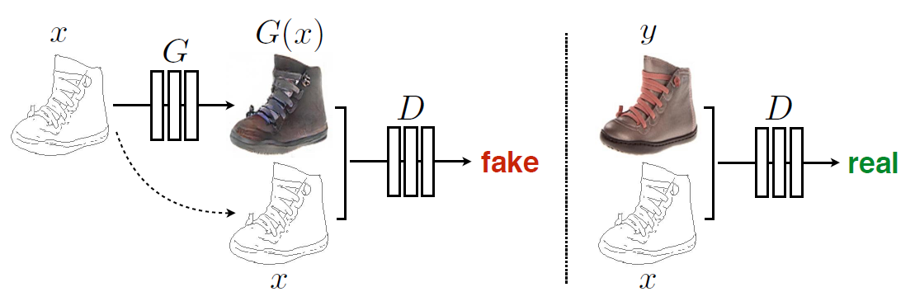
Networks
Conditional adversarial networks (cGANs)
Objective function:

Slide 7
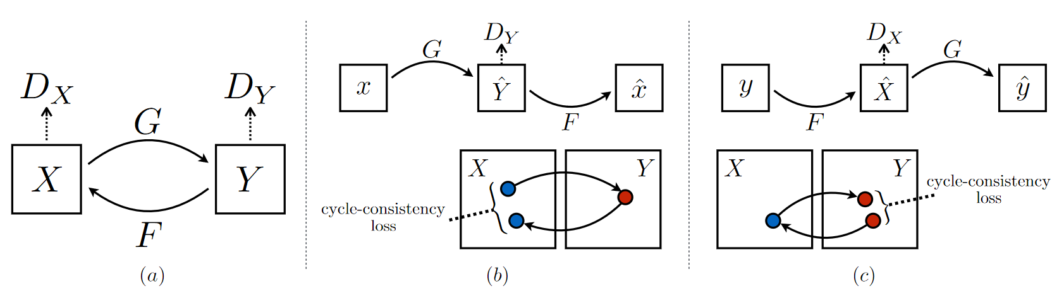
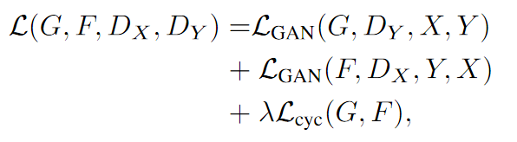
Networks
Cycle-consistent adversarial networks (CycleGANs)
Objective function:

Slide 8
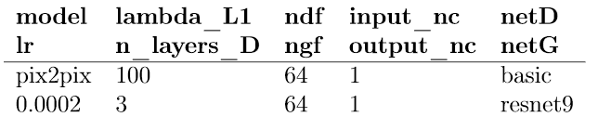
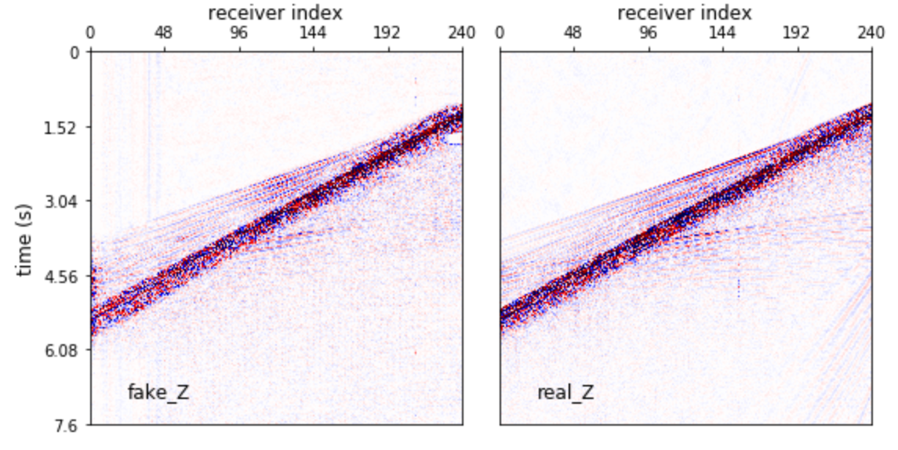
Experiments
Analysis of the hyperparameters

Slide 9
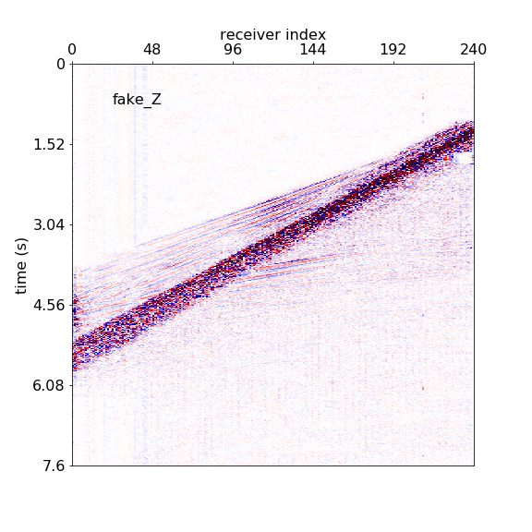

Slide 10
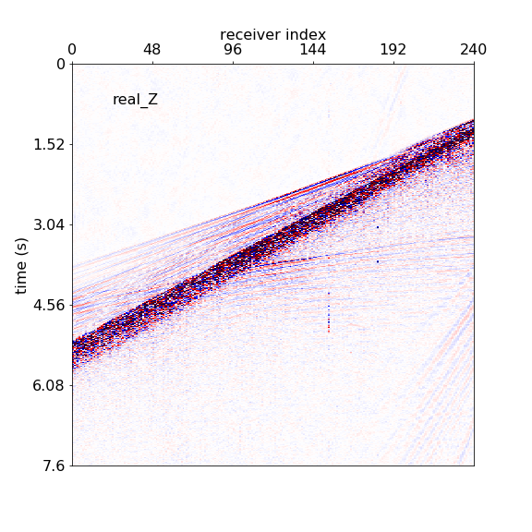

Slide 11
Experiments
Solution:
increase lr from 0.0002 to 0.002
Problem:
blank patch
features lost
Hypothesis:
learning rate too low, the network did not progress to the optimum.

Slide 12
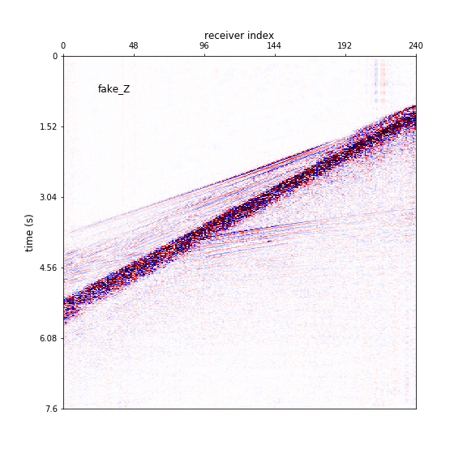

Slide 13
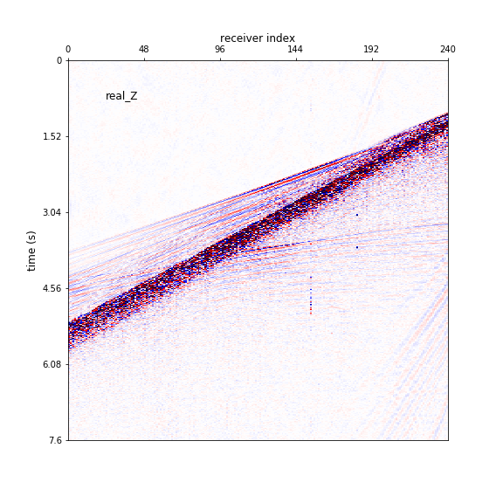

Slide 14
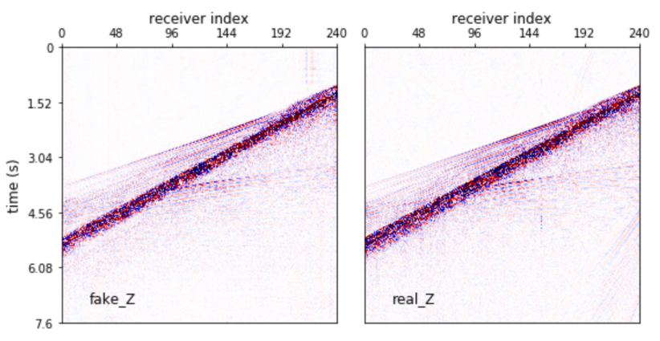
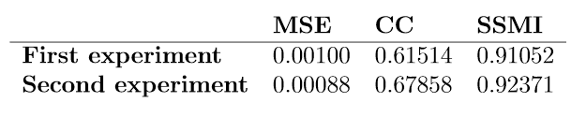
Experiments
Improvement:
fix the blank patch
Problem:
blurring
features lost

Slide 15
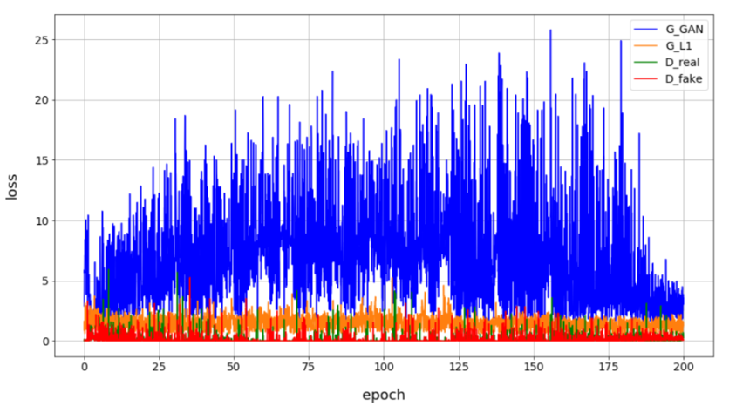
Experiments
Problem:
D loss reduce to 0 from early epochs
Solution:
cripple the discriminator

Slide 16
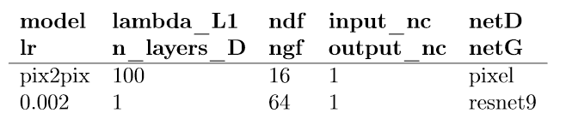
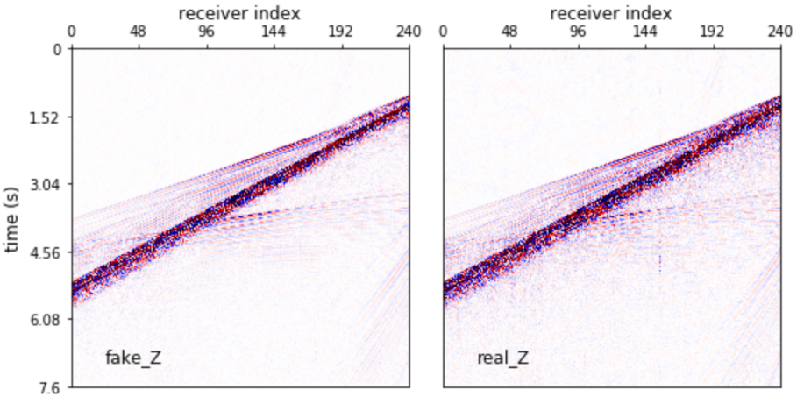
Experiments

Slide 17
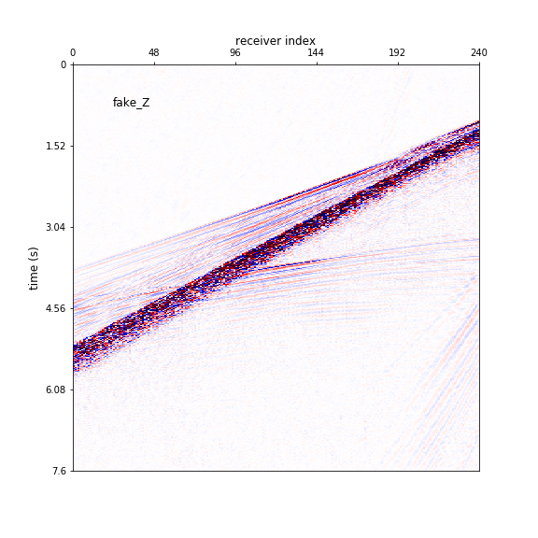
Weaker discriminator

Slide 19
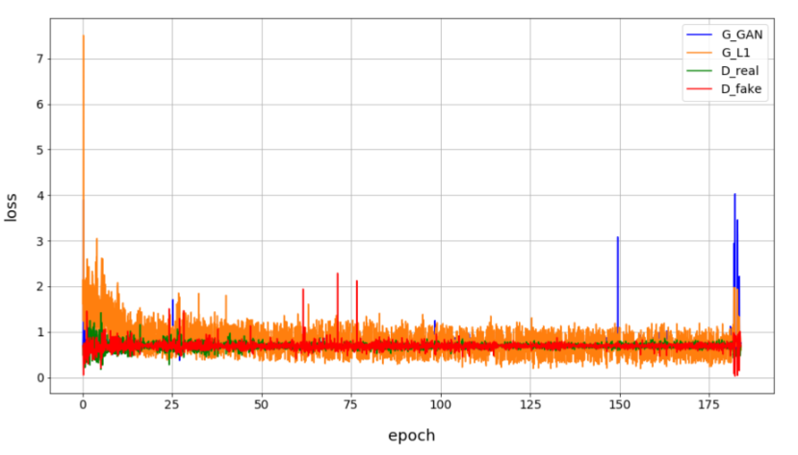
Experiments
Problem:
loss collapsed near the end
Solution:
add random noise
increase the lambda

Slide 20
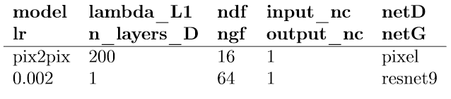
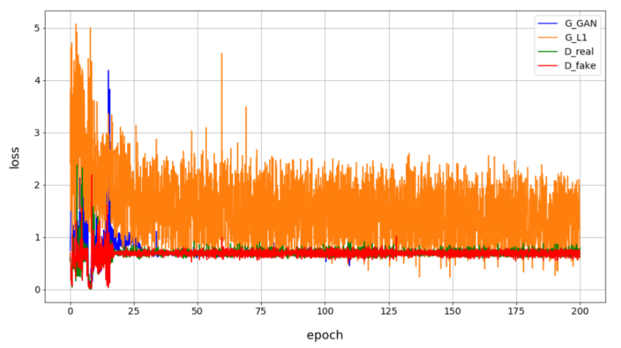
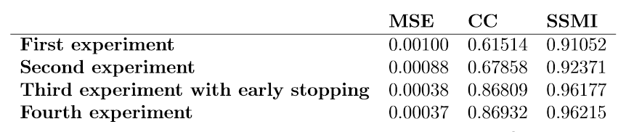
Experiments
Oscillate during the first 25 epochs,
eventually stabilize

Slide 21
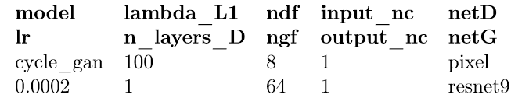
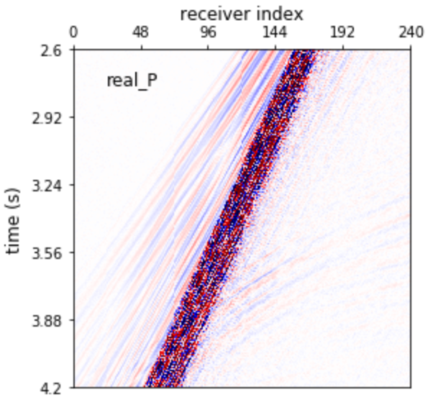
Experiments
Analysis of the networks - implementation of the CycleGAN architecture
CycleGAN: two networks
Memory out problem
Crop dataset: 900 x 240 pixels

Slide 22
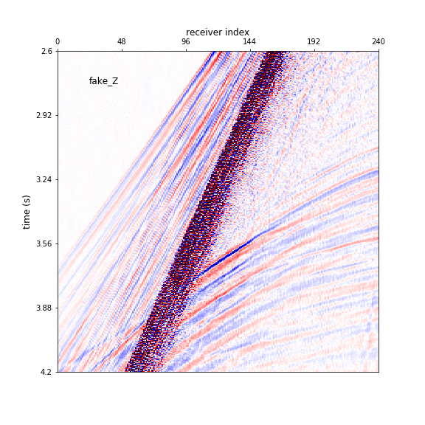

Slide 23
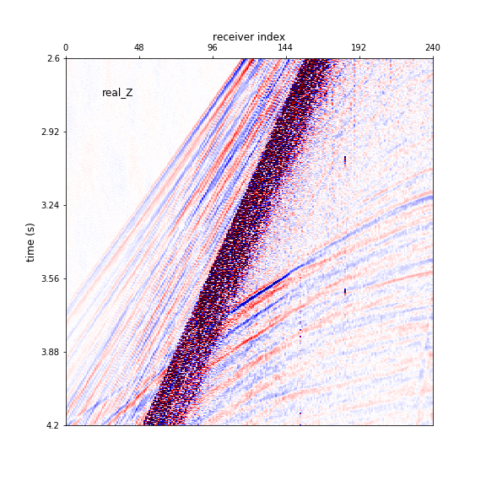

Slide 24
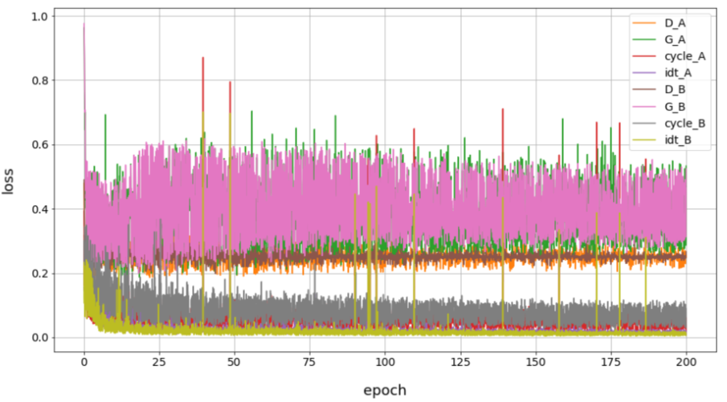
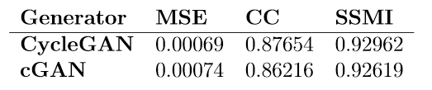
Experiments
D loss, G loss:
Compete and oscillate
Idt loss, cycle loss:
Reduce to low levels
Two extra losses set a more strict constraint

Slide 25
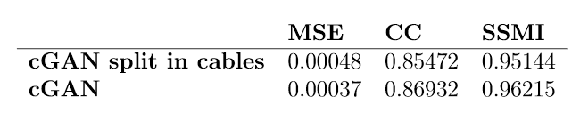
Extension
Segmented dataset:
Cable 1 & 3 & 5 & 7 for train
Cable 2 & 4 & 6 & 8 for test
Train set: 1168 gathers
Test set: 1168 gathers

Slide 26
Conclusion
Both cGANs and CycleGANs works.
CycleGANs achieve higher accuracy.
cGANs require less training time and memory.
Cheap and well suited for industrial applications.

Slide 27
Acknowledgement
Thanks to the support from my supervisor Prof. Mike Warner and Dr. Jiashun Yao.
Thanks to the support from all the academic and teaching staff from the department through the year.
Thanks to the moral support from my family and friends.

Slide 28
Conclusion
Both cGANs and CycleGANs works.
CycleGANs achieve higher accuracy.
cGANs require less training time and memory.
Cheap and well suited for industrial applications.

